Slide 1
Pozvánka od Honza Javorka:
“Václav Tunka odloží kávičku z Jávy a povypráví nám strašidelné historky z jeskyní Workflow-in-Open Soúrc, kde se bil se skřety a draky.”

Slide 2
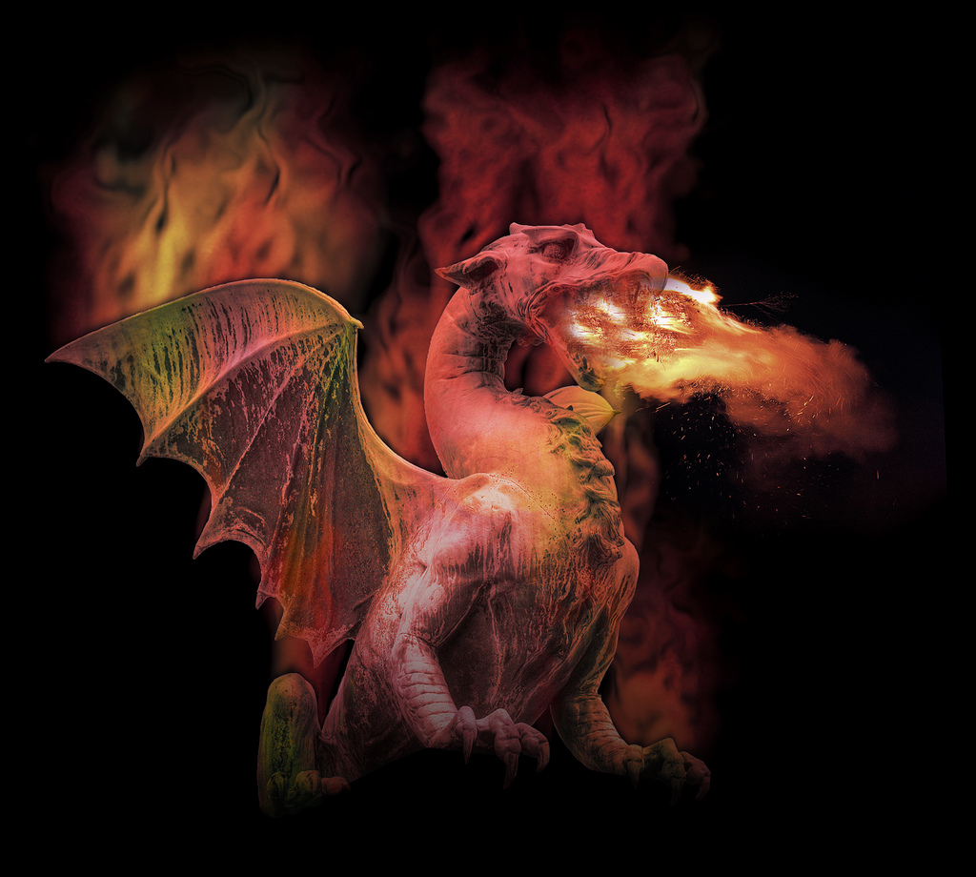
Fighting dragons with git
@naPyVo
@brugcz
25.4.2013
Git workflow for JBoss.org projects
Václav Tunka
Software engineer, JBoss by Red Hat
Twitter: @vtunka

Slide 3
Fork & Pull model
Everyone can fork our projects on github and then submit pull requests.
Pull requests get reviewed and merged by the maintainers with push access.
Challenge: Make the pull request integration more automated.

Slide 4
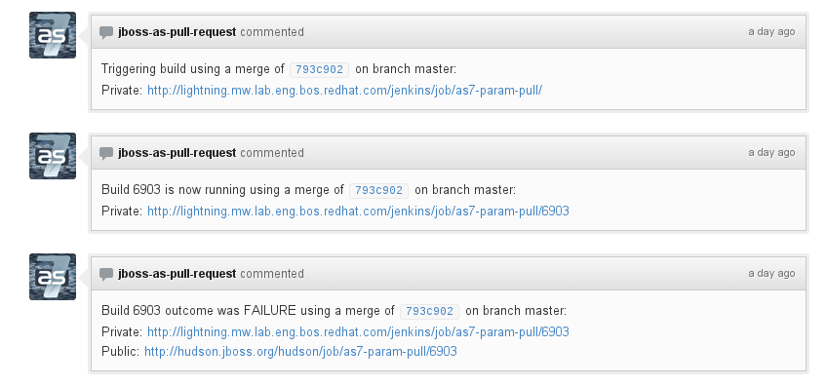
Pull request automation

Slide 5
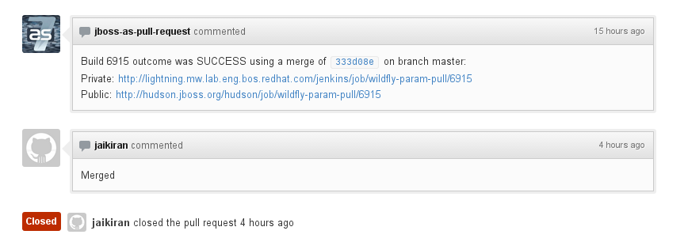
Pull request automation

Slide 6
Pull request automation
Every pull request is automatically tested against rebased master branch.
If user updates the pull request the whole process is restarted.
Users can type “retest this please” in the pull request comment to trigger new test-suite run.

Slide 7
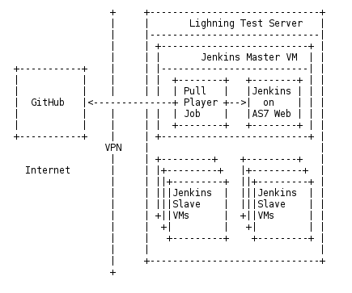
Pull request builder

Slide 8

Jenkins GitHub pull request builder plugin

Slide 9
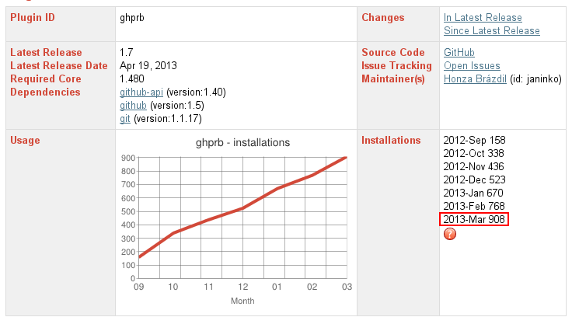
Jenkins GitHub pull request builder plugin

Slide 10
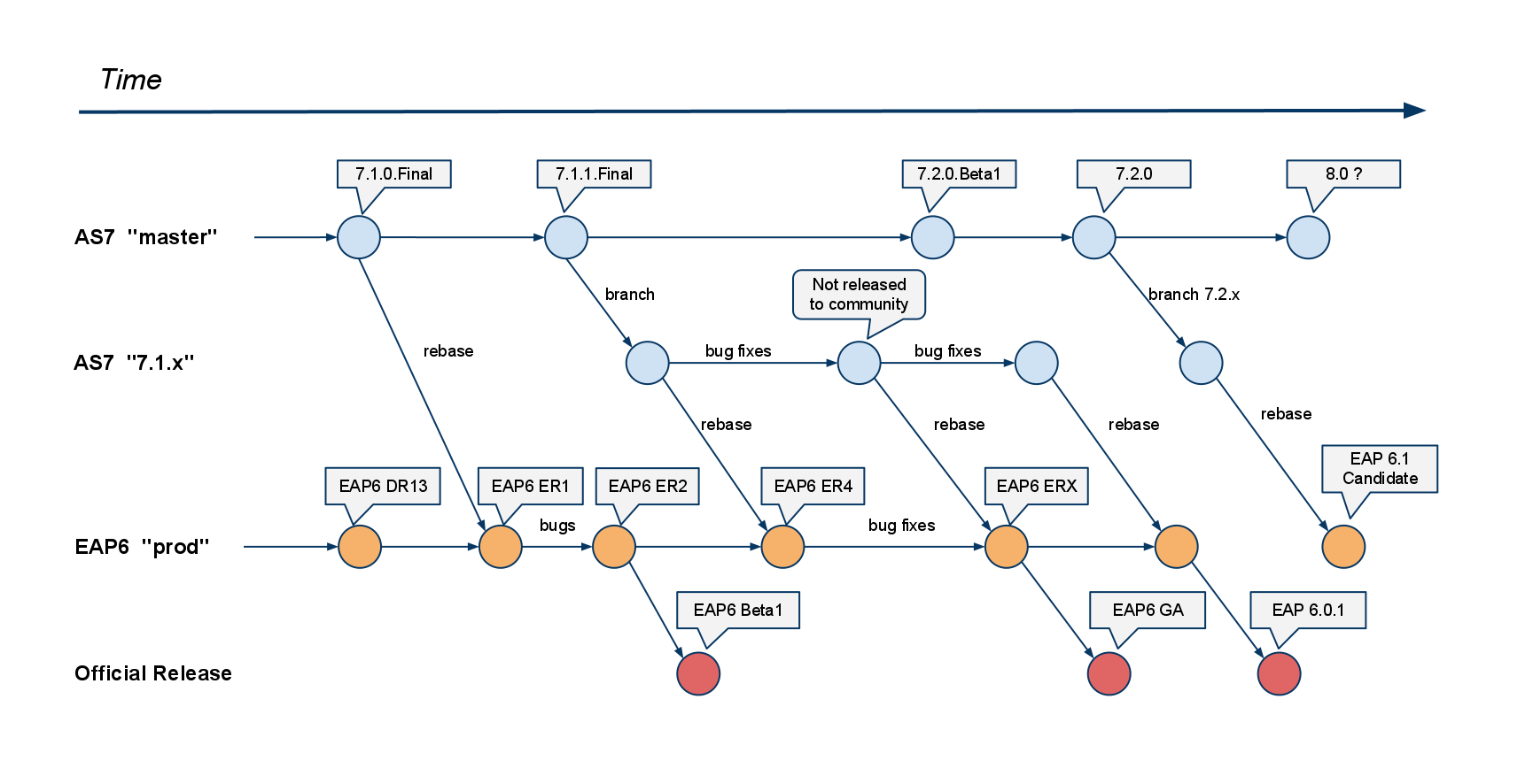
Project/Product git workflow

Slide 11
Questions?

Slide 12
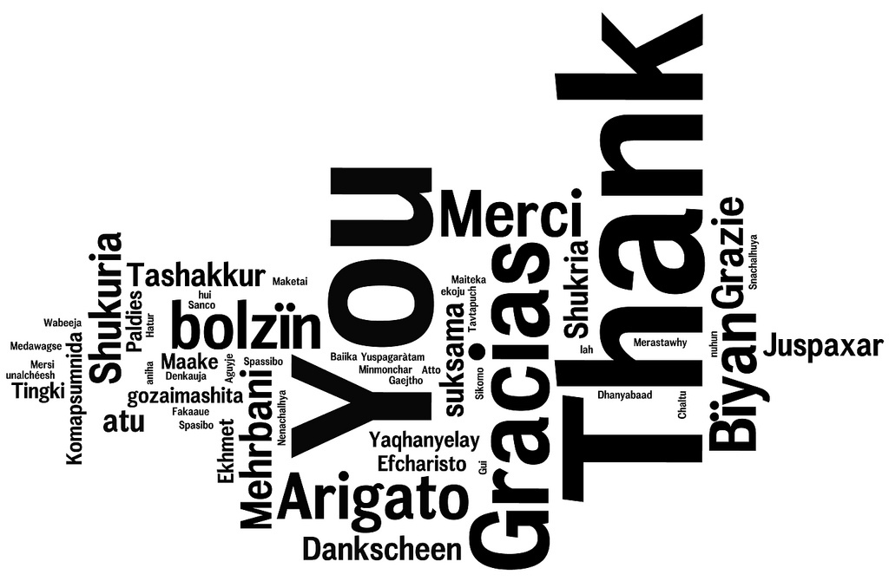

Slide 13
References
[1] Jenkins GitHub pull request builder plugin

Slide 14
Image References
PyVo community logo, courtesy of python.cz
CC Dragon image
CC Thanks image by woodleywonderworks

